Slide 1
Bootstrap Components
Components Based on CSS -Day 2

Slide 2
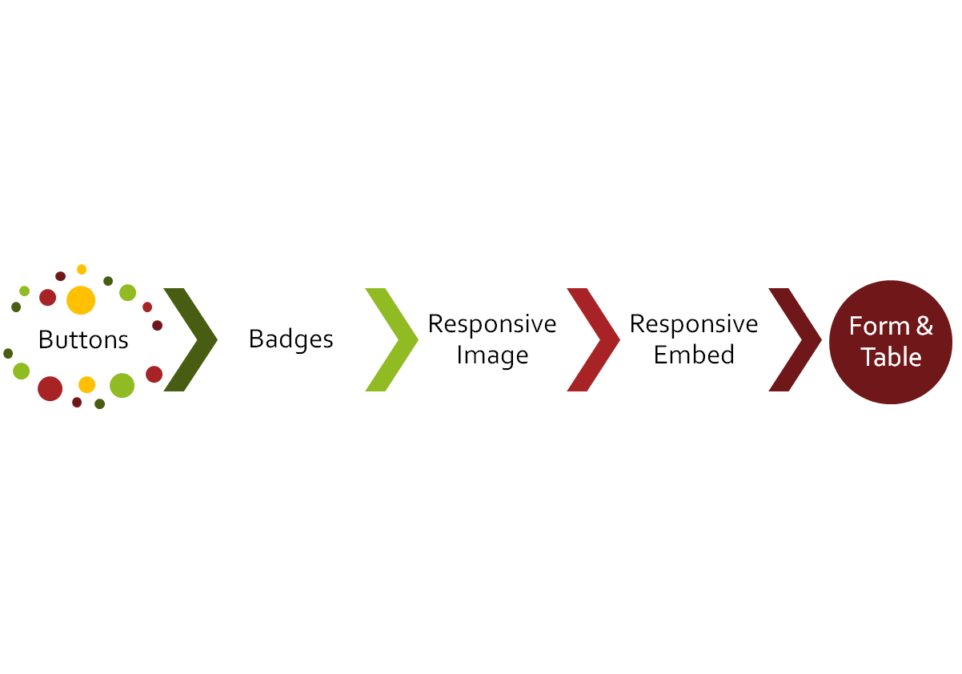
CLASS
OUTLINE

Slide 3
Bootstrap Components
In addition to achieving responsiveness, the bootstrap framework also comes with pre defined classes for common components found on the web.
After setting up the page layout, you can then determine where in the layout these components would be.

Slide 4
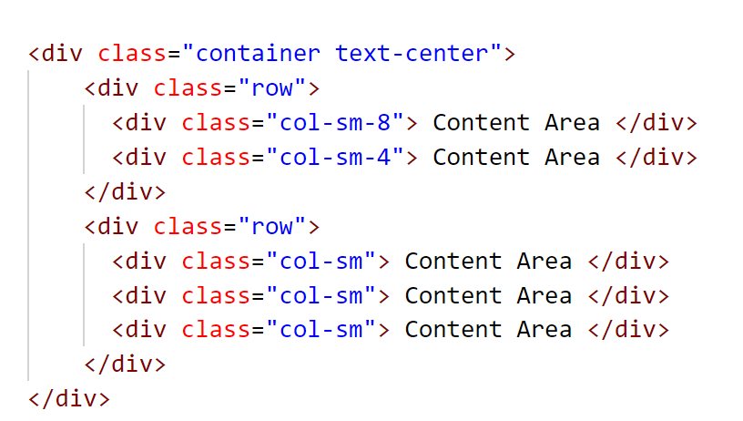
Layout Vs Components
Your website contents are the things you see on web pages; categorized as :
Textual contents, images, multimedia, form for data capture (recall from week 1)
There are 5 possible areas you can place contents in the layout below:

Slide 5
Alerts (found under Components)
Alerts provides contextual feedback to user actions, there are 8 contextual classes :
alert-primary, alert-secondary , alert-success , alert-danger , alert-warning, alert-info, alert-light , alert-dark
Use the alert class to create the necessary padding, add the alert-contextual class to add colors.
Can be applied to any tag
<div class="alert alert-primary" role="alert">
A simple primary alert—check it out!
</div>

Slide 6
Contextual colors for styling texts and background
The colors can be used to specify font colors and background colors too by preceding with text and bg respectively:
<p class="text-primary bg-primary">.text-primary</p>
<p class="text-secondary bg-secondary ">.text-secondary</p>
<p class="text-success bg-success">.text-success</p>
<p class="text-danger bg-danger">.text-danger</p>
<p class="text-warning bg-dark">.text-warning</p>
<p class="text-info bg-dark">.text-info</p>
<p class="text-light bg-dark">.text-light</p>
<p class="text-dark">.text-dark</p>
<p class="text-muted">.text-muted</p>
<p class="text-white bg-dark">.text-white</p>
<p class="text-black-50">.text-black-50</p>
<p class="text-white-50 bg-dark">.text-white-50</p>

Slide 7
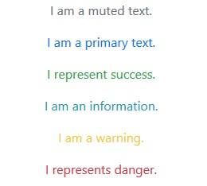
Contextual colors for texts
The classes for text colors are:.text-muted, .text-primary, .text-success, .text-info, .text-warning, and .text-danger:

Slide 8

Contextual colors for Background
The background can also be styled using any of : .bg-primary, .bg-success, .bg-info, .bg-warning, and .bg-danger

Slide 9

Introduction to the Official Documentation : https://getbootstrap.com

Slide 10
The Display Property
These are a group of responsive display utilities which can be mixed.
The general syntax is as follows:
.d-{value} for xs
.d-{breakpoint}-{value} for sm, md, lg, xl, and xxl.
Where value can be one of: none, inline, block, inline-block, flex
Examples: d-none will be set to display:none on all devices (smallest devices and above), d-sm-none will be set to display:none on small devices and above.
An application of this is to hide certain elements such as video on small devices and make it show on large screens

Slide 11

How do you hide the banner image on small devices?
See notes for answer
Notes:
Class d-none hides the image on the small device only, add d-md-block to make it show on other devices

Slide 12
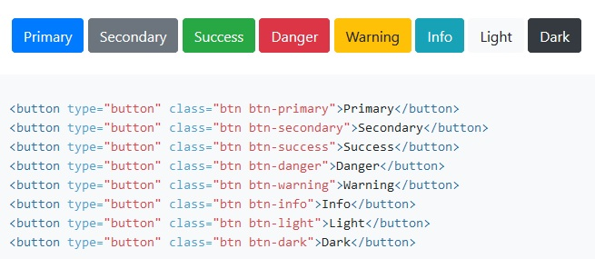
Button
You can style your button tag with the combination of class below:
The class btn which creates the necessary padding and the btn-contextual classes which can be applied to affect the colors.
It doesn’t have to be a button tag, it can be an input of type button too, it can even be an anchor tag!
Notes:
.sr-only can be used to display the visual effects created by the bootstrap classes to screen reader

Slide 13
Button
.btn-outline-contextual can be used to create a button with an outline
eg <button class=‘btn btn-outline-primary’>Register</button>
Add .btn-lg or .btn-sm to change the size
Make buttons look inactive by adding the disabled boolean attribute to any <button> element.
You can use the display block class to make a button a block level element
You can make use of the grid classes to make the button fill up the containing div eg
<button class=“col-6”>Submit</button> will occupy half of the conteining div

Slide 14
Badges and Typography
Bootstrap Components

Slide 15

Badges (found under Components)
A span can be created with the .badge class to provide labeling components, it can be used within a link or button to provide a counter for example.
It can be combined with the contextual classes to offer colors. (bg) eg bg-primary
The .rounded-pill can be further applied to badge to make it more rounded

Slide 16
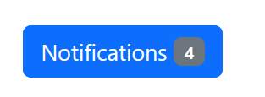
Badges (found under Components)
Since it works as an inline element, it can further be used within other elements like the button tag to provide more highlights

Slide 17
Typography, Spacing and Contextual colors
BS5 includes some responsive-friendly margin and padding
Spacing utilities that apply to all breakpoints, from xs to xl, have no breakpoint abbreviation in them
The classes are named using the format
  {property}{sides}-{size} for xs
  {property}{sides}-{breakpoint}-{size} for sm, md, lg, and xl.
  For example: mt-4 , mt-lg-4
  Properties are m (margin), p( padding)
  Sides: t (top) b (bottom), s (start), e (end), x (both *-left and *-right) , y (both *-top and *-bottom), blank(all 4 sides of the element)
  Size : 0 -5, auto - for classes that set the margin to auto
.mx-auto class can be used for horizontally centering fixed-width block level content—that is, content that has display: block and a width set
  <div class=‘mx-auto’>contents</div>

Slide 18
Responsive Image & Embed
Rather than set the image width and height, use the bootstrap image responsive classes

Slide 19

Responsive Image
Images can be made responsive in Bootstrap with the .img-fluid class, the image then scales with the parent element. Note that the image scales up with the parent (col div)
QUIZ: HOW DO YOU ACHIEVE THIS?
Notes:
Possible solutions:
SOLUTION ONE:
Two rows : ‘Featured Projects’ resides in the first row. The 3 images reside in the 2nd row
SOLUTION TWO:
One row with 4 columns div, the first column is col-12 and contains ‘Featured Projects’ , while others fall under it
NOTE: an image placed in col-6 will be bigger than that placed in col-2

Slide 20
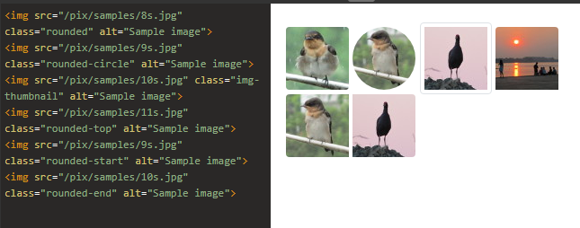
Responsive Image
In addition to img-fluid, you can add any of the following classes to further affect the look and feel of the image
Use .img-thumbnail to give an image a rounded 1px border appearance.
Use .rounded to make your image have rounded edge(s) as follows:

Slide 21
Responsive Embed
As much as possible, to achieve responsiveness, we avoid setting width (and height) for our elements
To make any embed element responsive, do not set width and height for the <iframe>,
In a parent element, add class .ratio and an aspect ratio class (eg ratio-16x9)
Other available ratio are; 1x1, 4x3, 16x9,21x9
The immediate child element is automatically sized
Note that the embedded object scales up with the parent, an object embedded in col-6 will be bigger than that in col-2
<div class="ratio ratio-16x9">
  <iframe src=“https://www.youtube.com/embed/zpOULjyy-n8?rel=0”></iframe>
</div>

Slide 22
Login Form
Lets create a simple login form with username, password fields respectively and a login button.

Slide 23
Bootstrap Forms (found under components)
Every label/input pair should be placed within a div to group them
<div>
<label for=“txtemail" class="form-label">Email address</label>
<input type="email" class="form-control" id="txtemail">
</div>
The containing div may be given the margin class to create space before the next div eg mb-3
Give all textual <input> and <textarea> elements class .form-control to get padding and 100% width
Add class .form-select to select menus
In addition to form-control, add form-control-lg or .form-control-sm and that of select menu with form-select-lg, form-select-sm to change the size of the form input elements
Add .form-label class to each label element

Slide 24
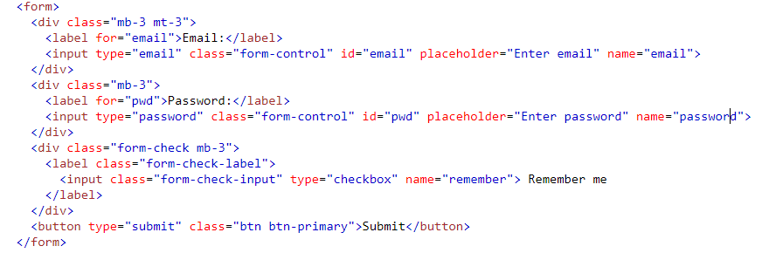
Bootstrap Forms

Slide 25
Checkboxes and radio buttons
checkboxes and radio buttons and their respective labels should be grouped together by placing them in a div with the class form-check
The label should have class form-check-label
and the checkbox/radio button should have form-check-input
<div class="form-check">
<input class="form-check-input" type="checkbox">
<label class="form-check-label">Option 1</label>
</div>

Slide 26
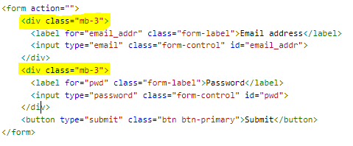
Default Form - Vertical
Each form label and its input field combination must be within a div with the margin bottom or margin top class “mb-3 mt-3”
<div class=“mb-3 mt-3”>
label and input
</div>
All textual input fields should each have class ‘form-control’.
Check the note for source code
Notes:
<div class='row'>
<div class='col'>
<form action="">
<div class="mb-3">
<label for="email_addr" class="form-label">Email address</label>
<input type="email" class="form-control" id="email_addr">
</div>
<div class="mb-3">
<label for="pwd" class="form-label">Password</label>
<input type="password" class="form-control" id="pwd">
</div>
<button type="submit" class="btn btn-primary">Submit</button>
</form> </div>
</div>

Slide 27
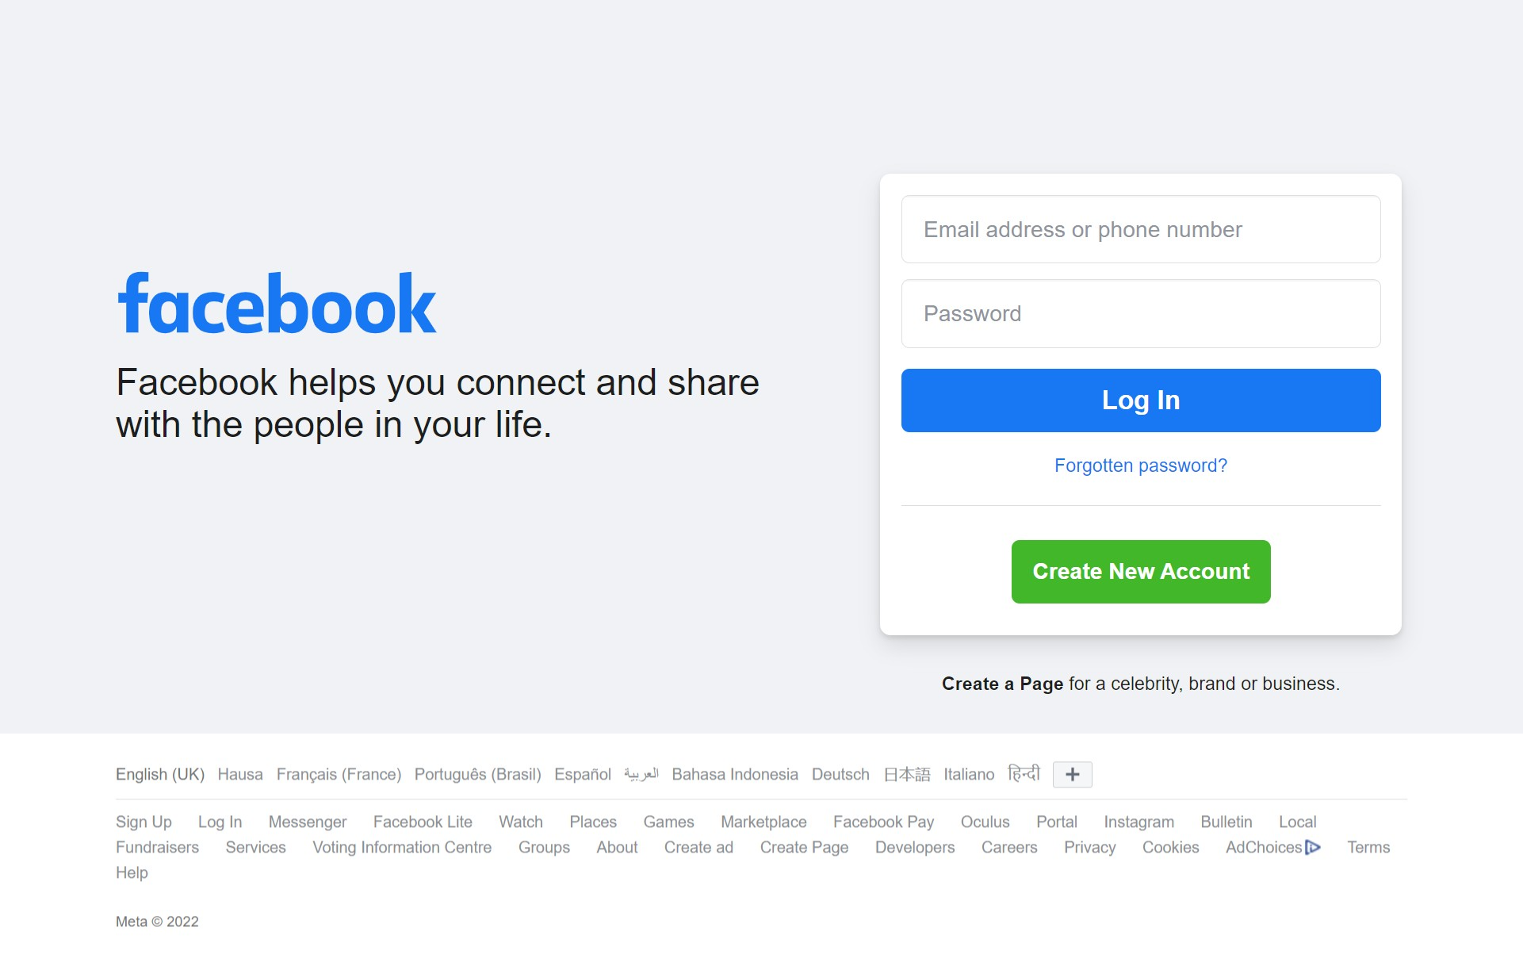

Achieve this responsively – The new Face book Home page
On a large screen
On a mobile phone

Slide 28
KEEP CODING!
Being relaxed, at peace with yourself, confident, emotionally neutral, loose, and free-floating – these are the keys to successful performance in almost everything. ~ Dr. Wayne W. Dyer

